Slide 1
Intervention Trigger I(t) = 0.0182

Slide 2
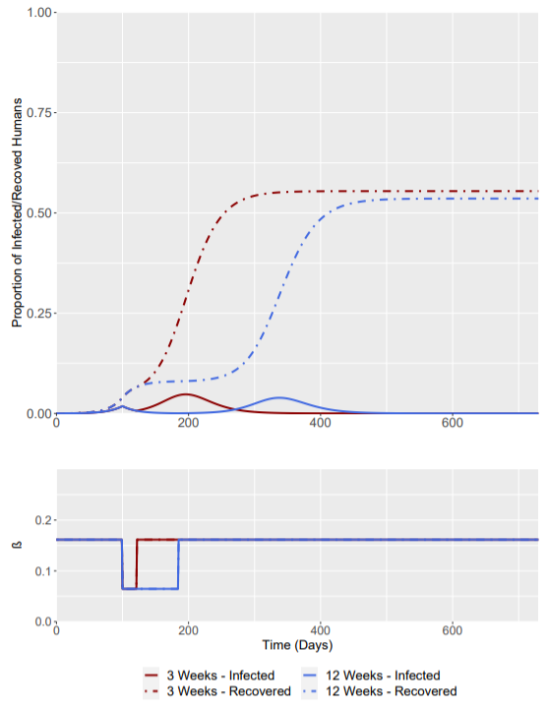
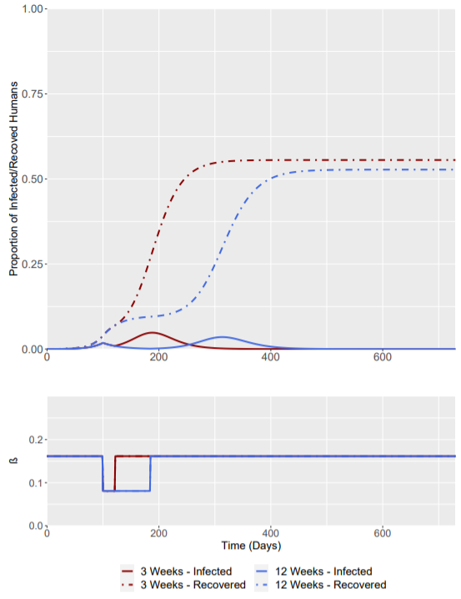
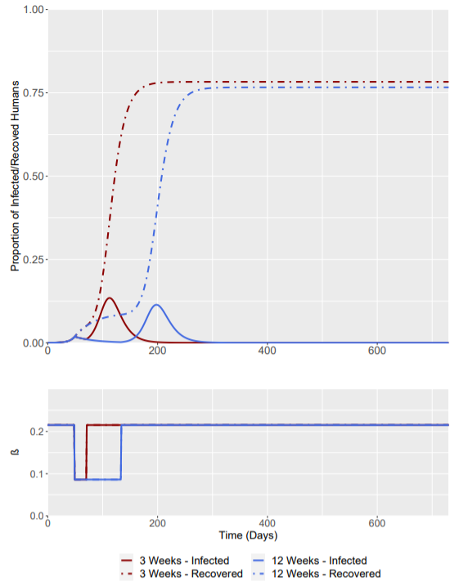
R₀ = 1.5 -> R₀ = 0.6 (Baseline)
R₀ = 1.5 -> R₀ = 0.75
R₀ = 2.0 -> R₀ = 0.8

Slide 3
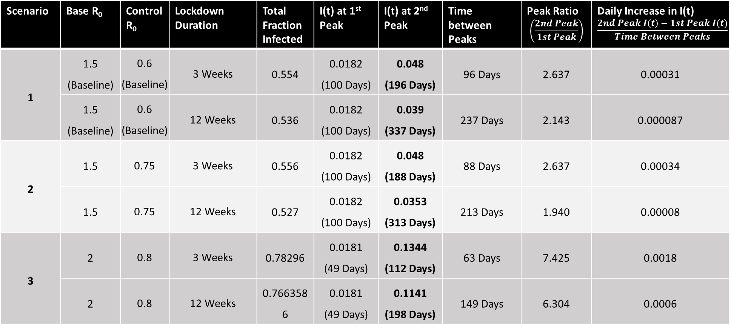
Intervention Trigger = when I(t) = 0.0182 (at t = 100 Days for Scenario 1 + 2; at t = 49 for Scenario 3)
Bold Denotes highest peak (in terms of I(t))
Scenario | Base R₀ | Control R₀ | Lockdown Duration | Total Fraction Infected | I(t) at 1st Peak | I(t) at 2nd Peak | Time between Peaks | Peak Ratio $$\left(\frac{2nd Peak}{1st Peak}\right)$$ | Daily Increase in I(t) $$\frac{2nd Peak I\left(t\right)−1st Peak I(t)}{Time Between Peaks}$$
1 | 1.5 (Baseline) | 0.6 (Baseline) | 3 Weeks | 0.554 | 0.0182 (100 Days) | 0.048 (196 Days) | 96 Days | 2.637 | 0.00031
 | 1.5 (Baseline) | 0.6 (Baseline) | 12 Weeks | 0.536 | 0.0182 (100 Days) | 0.039 (337 Days) | 237 Days | 2.143 | 0.000087
2 | 1.5 | 0.75 | 3 Weeks | 0.556 | 0.0182 (100 Days) | 0.048 (188 Days) | 88 Days | 2.637 | 0.00034
 | 1.5 | 0.75 | 12 Weeks | 0.527 | 0.0182 (100 Days) | 0.0353 (313 Days) | 213 Days | 1.940 | 0.00008
3 | 2 | 0.8 | 3 Weeks | 0.78296 | 0.0181 (49 Days) | 0.1344 (112 Days) | 63 Days | 7.425 | 0.0018
 | 2 | 0.8 | 12 Weeks | 0.7663586 | 0.0181 (49 Days) | 0.1141 (198 Days) | 149 Days | 6.304 | 0.0006

Slide 4
Intervention Trigger I(t) = 0.0054

Slide 5
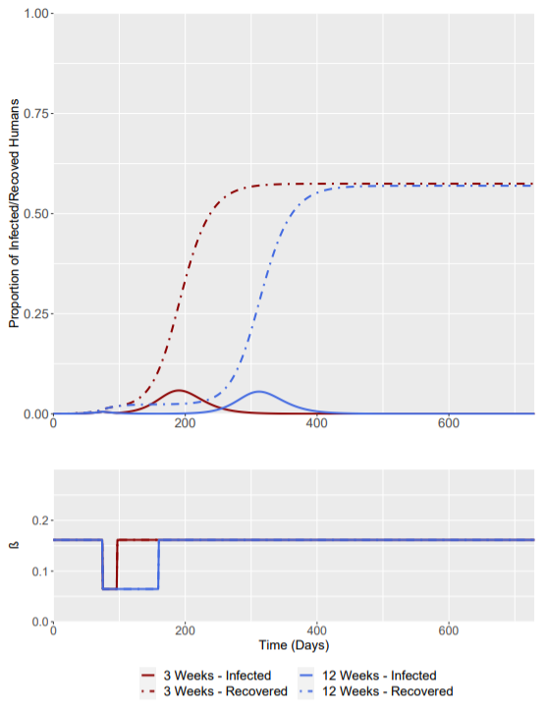
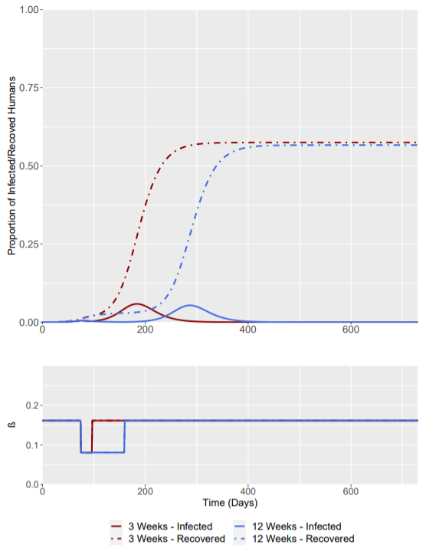
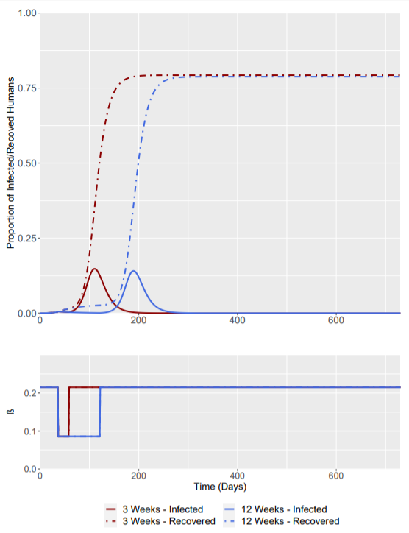
R₀ = 1.5 -> R₀ = 0.6 (Baseline)
R₀ = 1.5 -> R₀ = 0.75
R₀ = 2.0 -> R₀ = 0.8

Slide 6
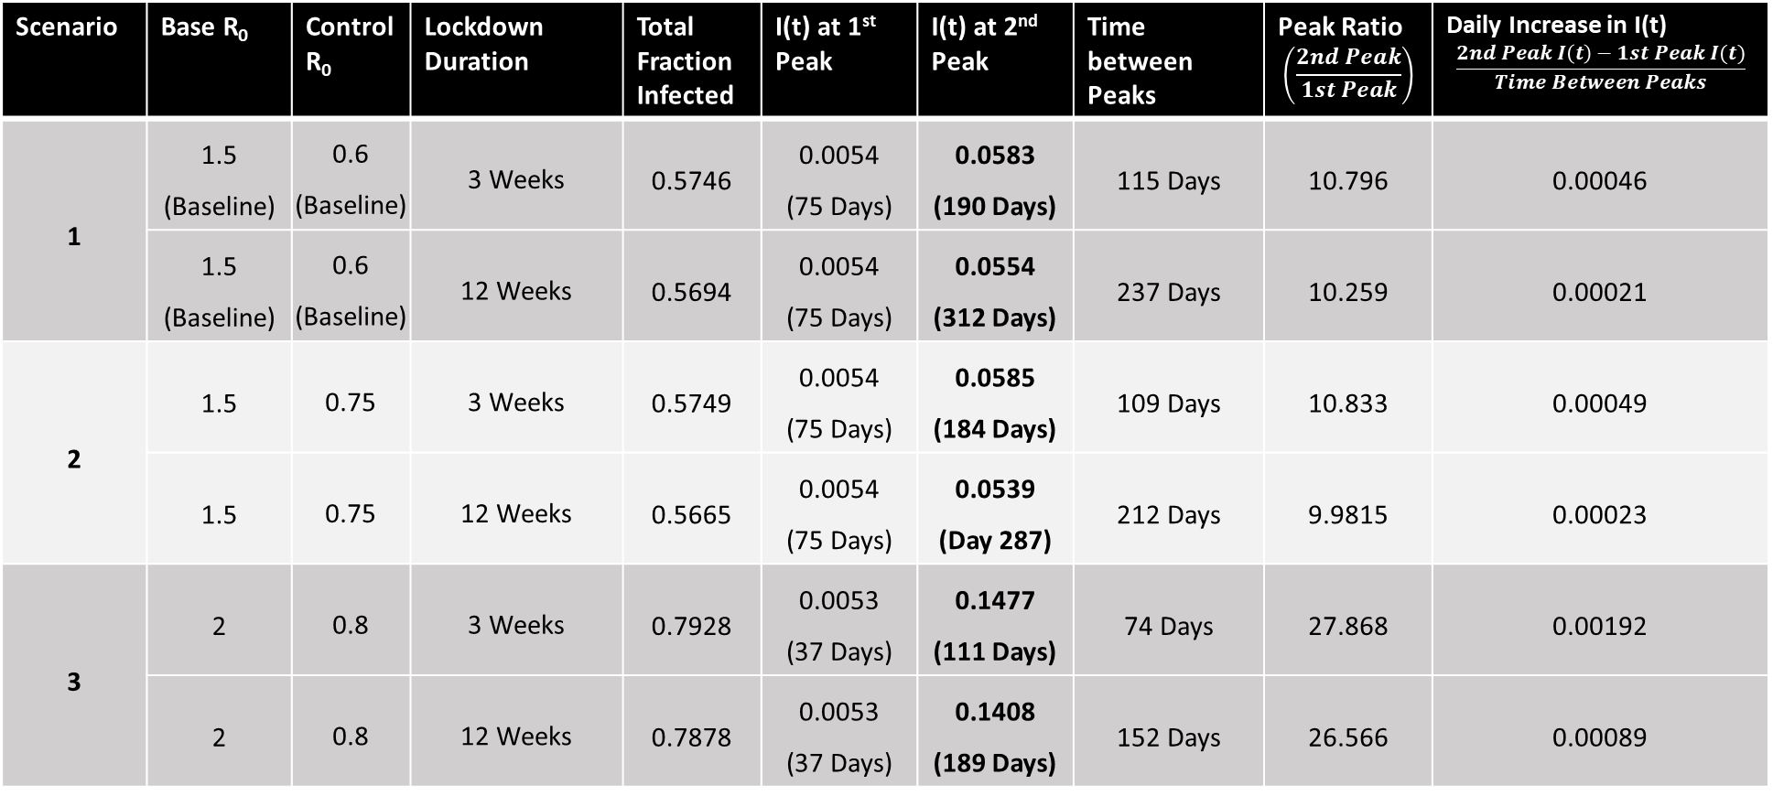
Intervention Trigger = when I(t) = 0.0054 (at t = 75 Days for scenario 1 + 2; at t = 37 Days for scenario 3)
Bold Denotes Highest I(t) Peak
Scenario | Base R₀ | Control R₀ | Lockdown Duration | Total Fraction Infected | I(t) at 1st Peak | I(t) at 2nd Peak | Time between Peaks | Peak Ratio $$\left(\frac{2nd Peak}{1st Peak}\right)$$ | Daily Increase in I(t) $$\frac{2nd Peak I\left(t\right)−1st Peak I(t)}{Time Between Peaks}$$
1 | 1.5 (Baseline) | 0.6 (Baseline) | 3 Weeks | 0.5746 | 0.0054 (75 Days) | 0.0583 (190 Days) | 115 Days | 10.796 | 0.00046
 | 1.5 (Baseline) | 0.6 (Baseline) | 12 Weeks | 0.5694 | 0.0054 (75 Days) | 0.0554 (312 Days) | 237 Days | 10.259 | 0.00021
2 | 1.5 | 0.75 | 3 Weeks | 0.5749 | 0.0054 (75 Days) | 0.0585 (184 Days) | 109 Days | 10.833 | 0.00049
 | 1.5 | 0.75 | 12 Weeks | 0.5665 | 0.0054 (75 Days) | 0.0539 (Day 287) | 212 Days | 9.9815 | 0.00023
3 | 2 | 0.8 | 3 Weeks | 0.7928 | 0.0053 (37 Days) | 0.1477 (111 Days) | 74 Days | 27.868 | 0.00192
 | 2 | 0.8 | 12 Weeks | 0.7878 | 0.0053 (37 Days) | 0.1408 (189 Days) | 152 Days | 26.566 | 0.00089

Slide 7
Intervention Trigger I(t) = 0.0455

Slide 8
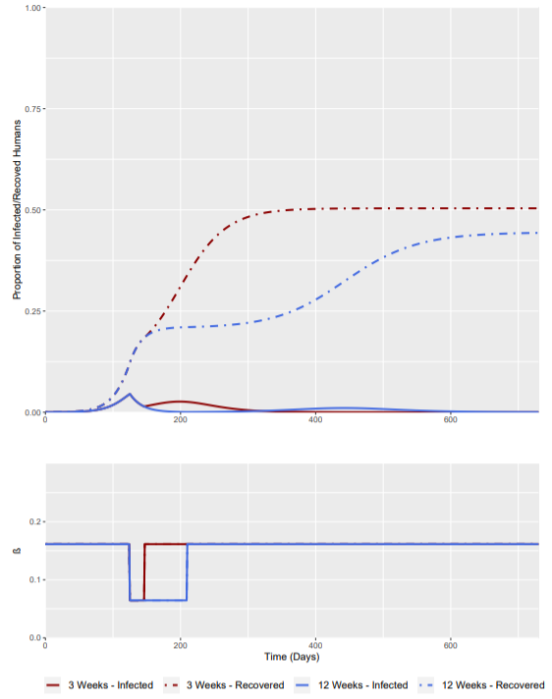
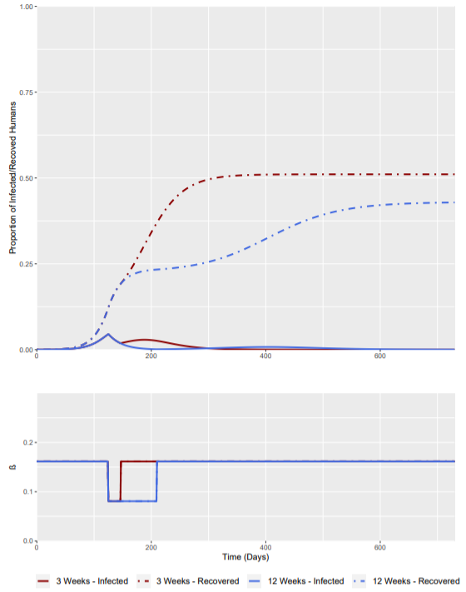
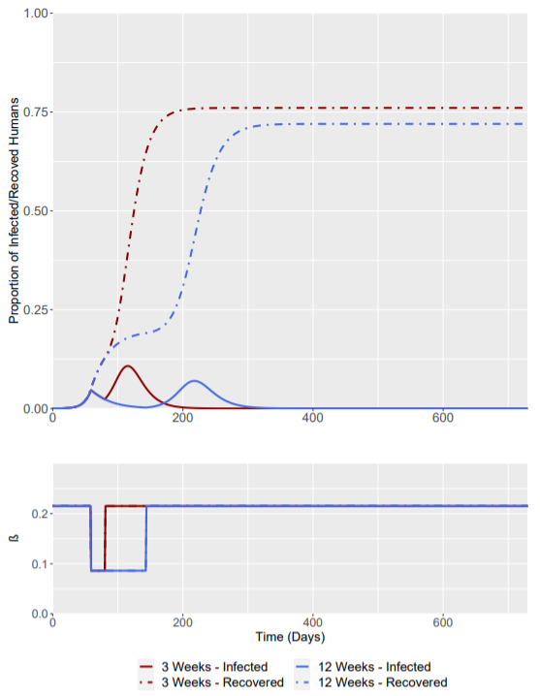
R₀ = 1.5 -> R₀ = 0.6 (Baseline)
R₀ = 1.5 -> R₀ = 0.75
R₀ = 2.0 -> R₀ = 0.8

Slide 9
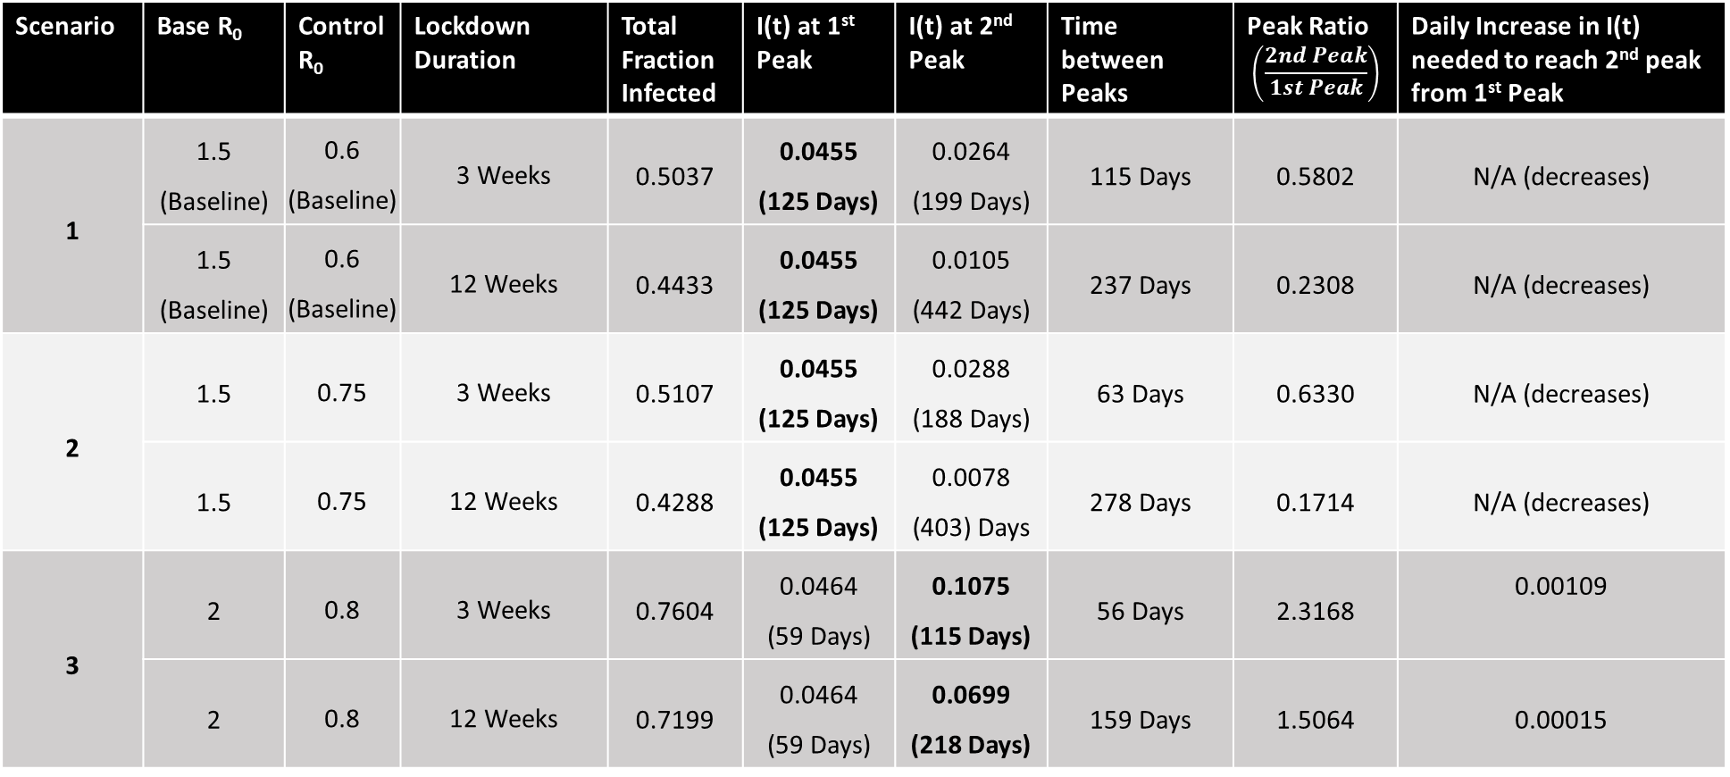
Intervention Trigger = when I(t) = 0.0455 (at t = 125 Days for scenario 1 + 2, at t = 59 Days for scenario 3)
Bold Denotes Highest I(t) Peak
Scenario | Base R₀ | Control R₀ | Lockdown Duration | Total Fraction Infected | I(t) at 1st Peak | I(t) at 2nd Peak | Time between Peaks | Peak Ratio $$\left(\frac{2nd Peak}{1st Peak}\right)$$ | Daily Increase in I(t) needed to reach 2nd peak from 1st Peak
1 | 1.5 (Baseline) | 0.6 (Baseline) | 3 Weeks | 0.5037 | 0.0455 (125 Days) | 0.0264 (199 Days) | 115 Days | 0.5802 | N/A (decreases)
 | 1.5 (Baseline) | 0.6 (Baseline) | 12 Weeks | 0.4433 | 0.0455 (125 Days) | 0.0105 (442 Days) | 237 Days | 0.2308 | N/A (decreases)
2 | 1.5 | 0.75 | 3 Weeks | 0.5107 | 0.0455 (125 Days) | 0.0288 (188 Days) | 63 Days | 0.6330 | N/A (decreases)
 | 1.5 | 0.75 | 12 Weeks | 0.4288 | 0.0455 (125 Days) | 0.0078 (403) Days | 278 Days | 0.1714 | N/A (decreases)
3 | 2 | 0.8 | 3 Weeks | 0.7604 | 0.0464 (59 Days) | 0.1075 (115 Days) | 56 Days | 2.3168 | 0.00109
 | 2 | 0.8 | 12 Weeks | 0.7199 | 0.0464 (59 Days) | 0.0699 (218 Days) | 159 Days | 1.5064 | 0.00015

